Slide 1

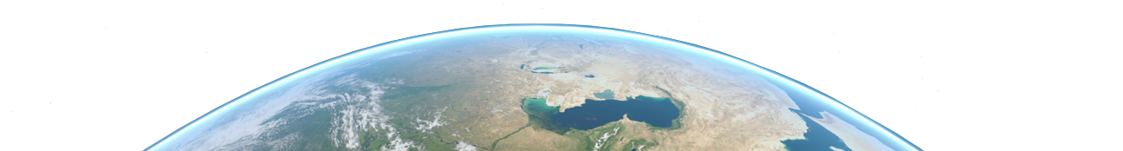


Mission Analysis in Python
A “how-to” crash course
10/2023

Slide 2

Table of Contents
Introduction
Introduction
Tools Used & Recommended
Installation & Testing
Collaborative Coding - GitHub
Useful Links
TOLOSAT
05/2021
Mission Analysis in Python
2

Slide 3


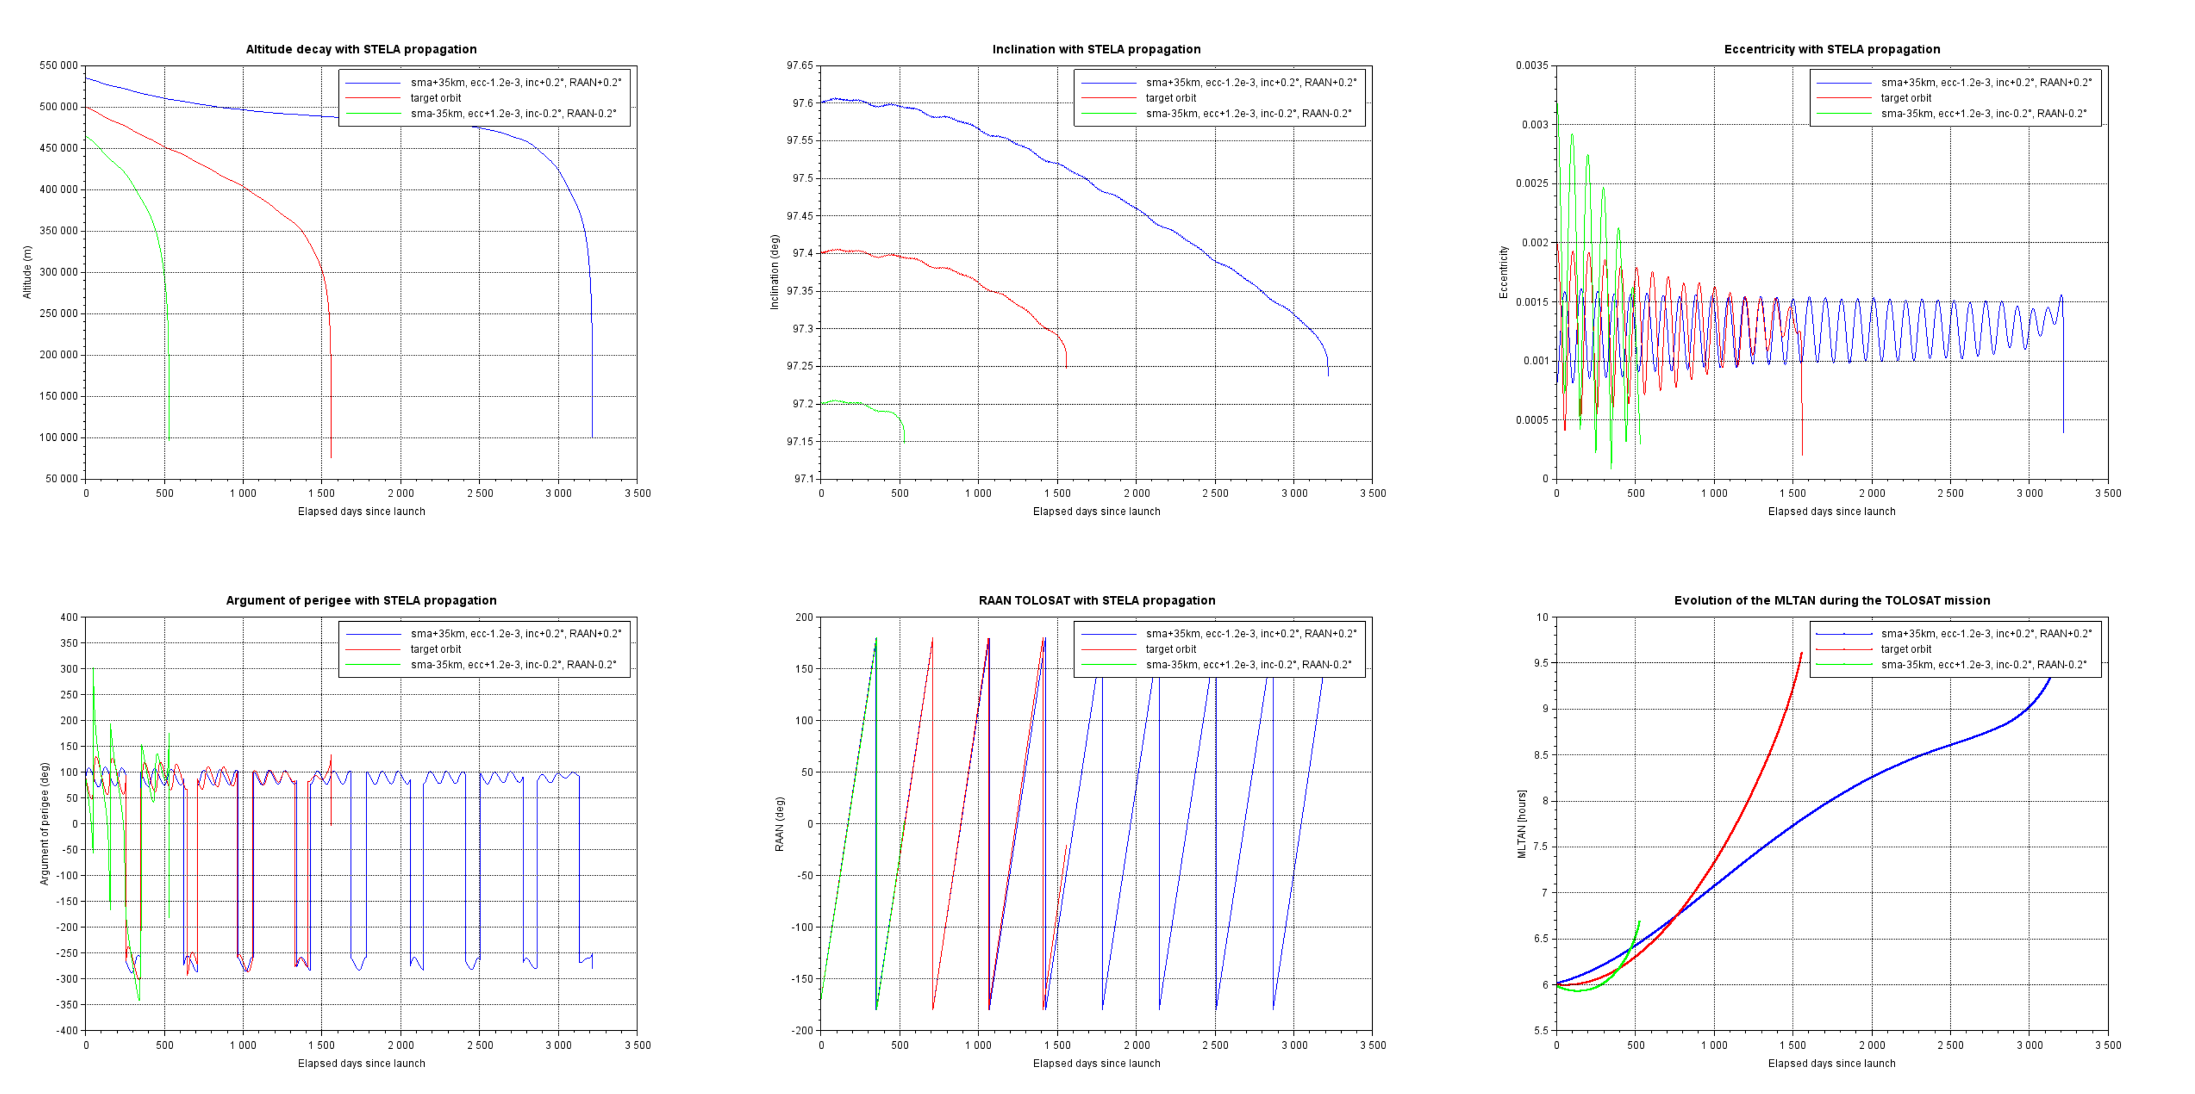
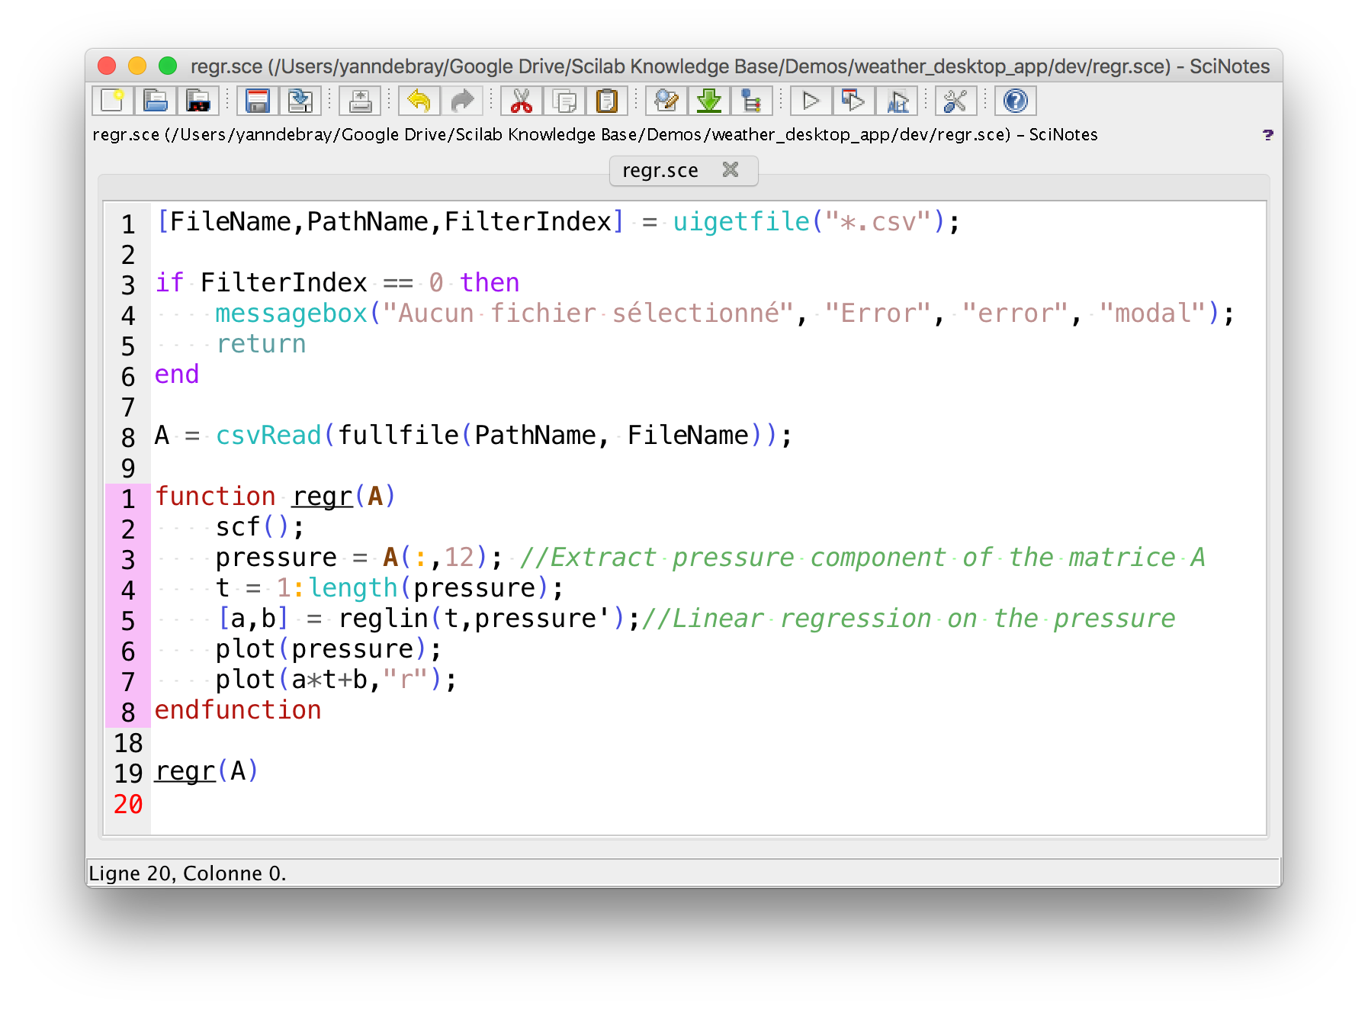
Introduction
Some historical context
TOLOSAT
05/2021
Mission Analysis in Python
3

Slide 4
Introduction
TOLOSAT
Why move to Python ?
More modern and flexible language
Easy to learn and use, still allows for high-performance applications through interfaces
Scilab very limiting and outdated (CNES also looking into moving to Python)
Opens access to many free and open-source libraries available
Free choice of IDE and development environment, can wield the power of plugins, etc.
More modular code, easier to collaborate with other subsystems when needed
05/2021
Mission Analysis in Python
4

Slide 5







Tools Used & Recommended
Used
Recommended
TOLOSAT
GitHub Desktop
05/2021
Mission Analysis in Python
5

Slide 6
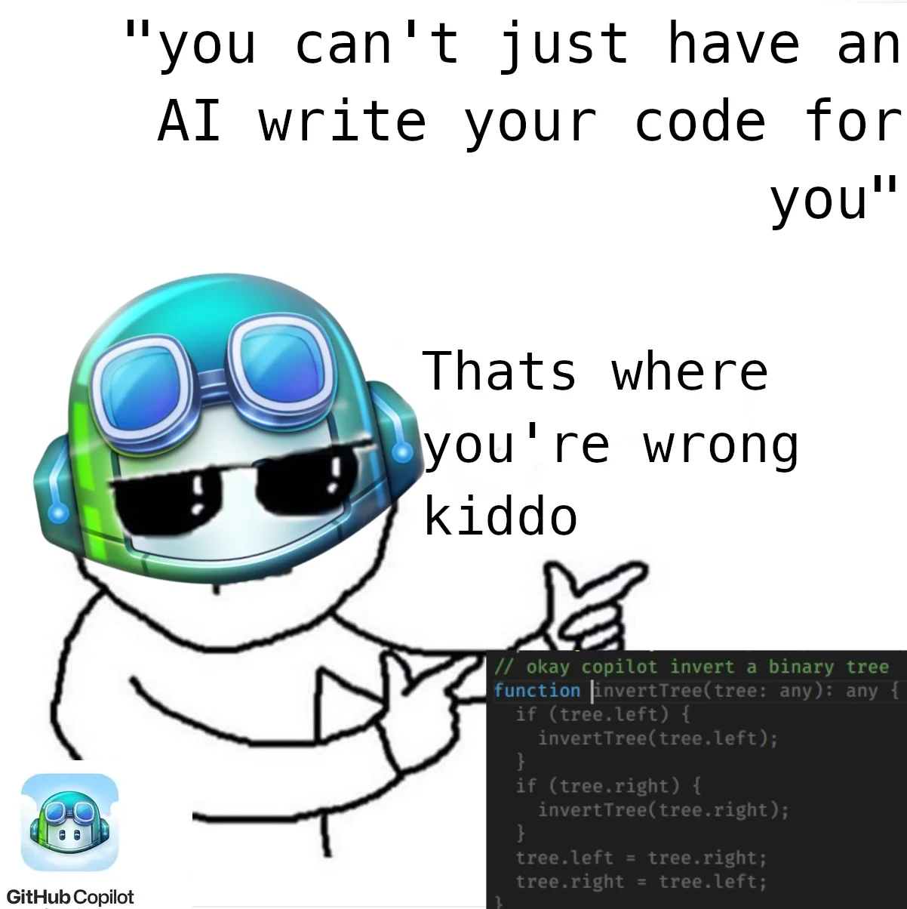
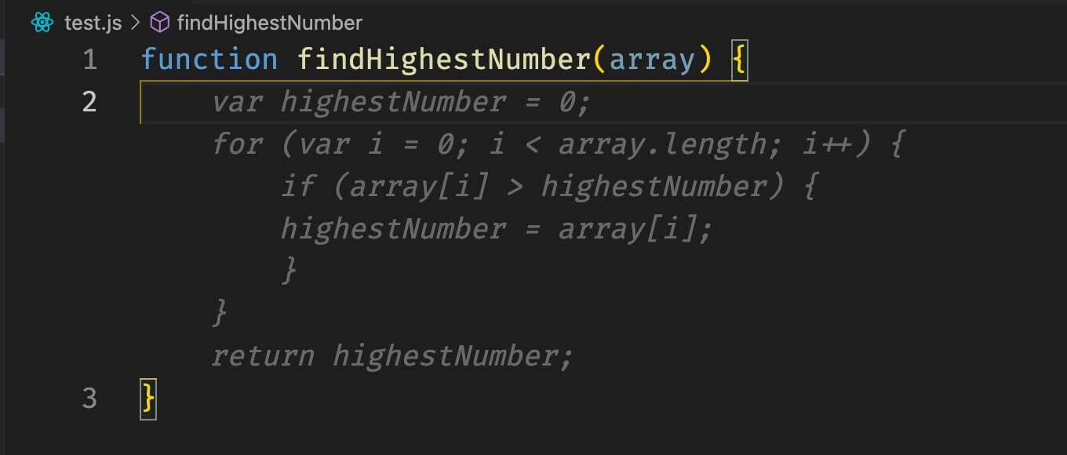
Tools Used & Recommended
Important notes
CONDA → You can use ANACONDA, or Miniforge for a lighter install
PyCharm → Free professional licenses for students (see Python setup guide)
GitHub Copilot → Free for students through the GitHub Global Campus program
TOLOSAT
05/2021
Mission Analysis in Python
6

Slide 7
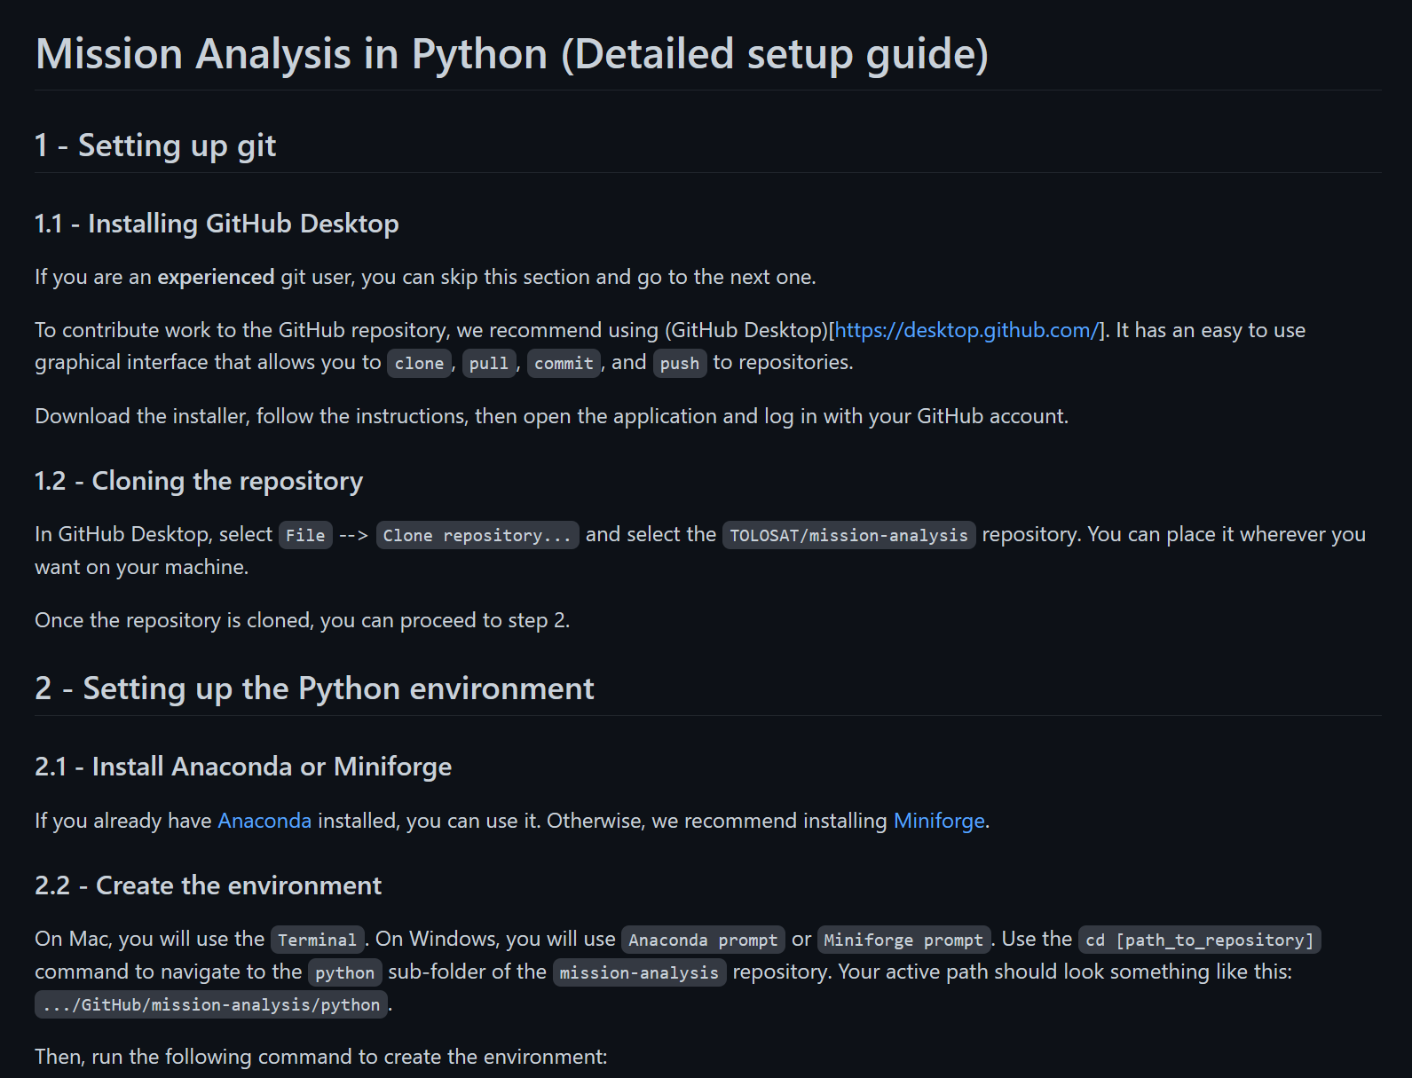
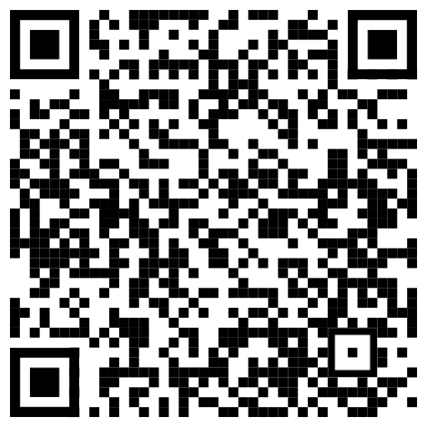
Installation & Testing
https://github.com/TOLOSAT/mission-analysis/blob/main/python/setup_guide/README.md
TOLOSAT
05/2021
Mission Analysis in Python
7

Slide 8
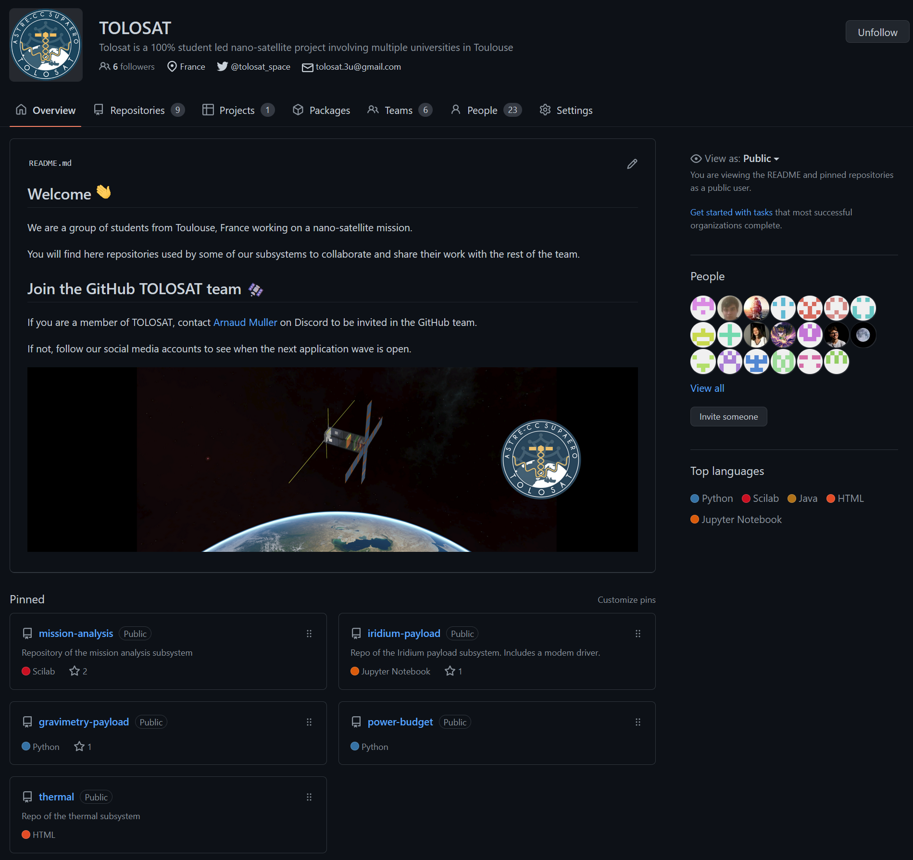
Collaborative Coding - GitHub
TOLOSAT
05/2021
Mission Analysis in Python
8

Slide 9
Collaborative Coding - GitHub
TOLOSAT
SOME GITHUB VOCABULARY
BRANCH = Copy of main repository. Used to safely experiment without changing main.
FETCH = Refresh page to see latest version of repository on the cloud.
PULL = Download what has been fetched, substituting what is on local repository.
COMIT = Records changes to repository (local repository).
PUSH = Updating GitHub repository with commited changes (remote repository).
05/2021
Mission Analysis in Python
9

Slide 10
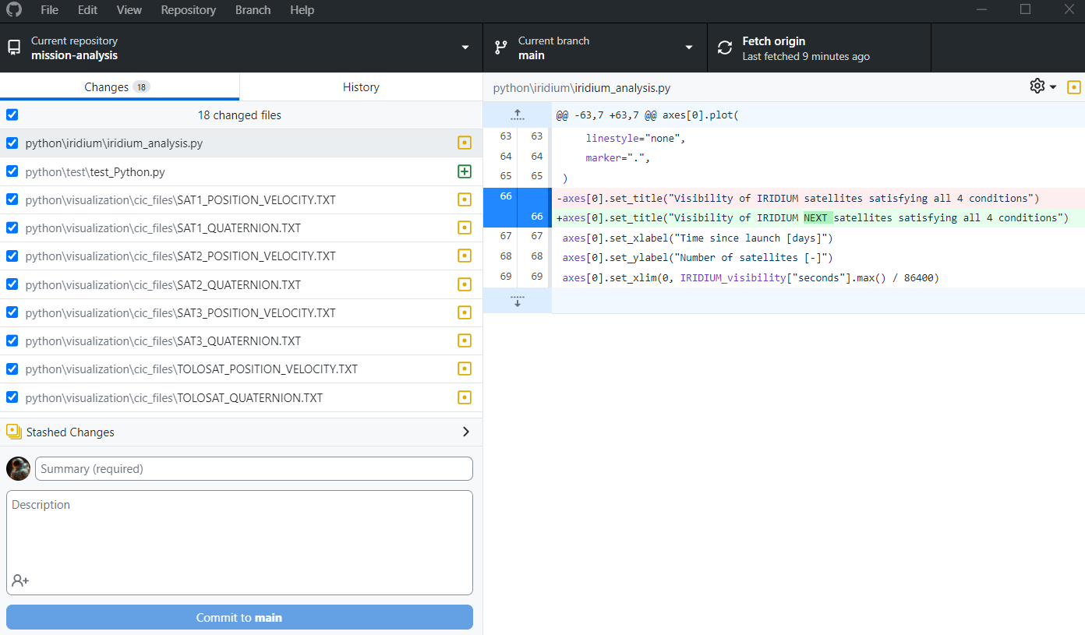
Collaborative Coding – GitHub Desktop
TOLOSAT
1
2
3
4
5
05/2021
Mission Analysis in Python
10

Slide 11
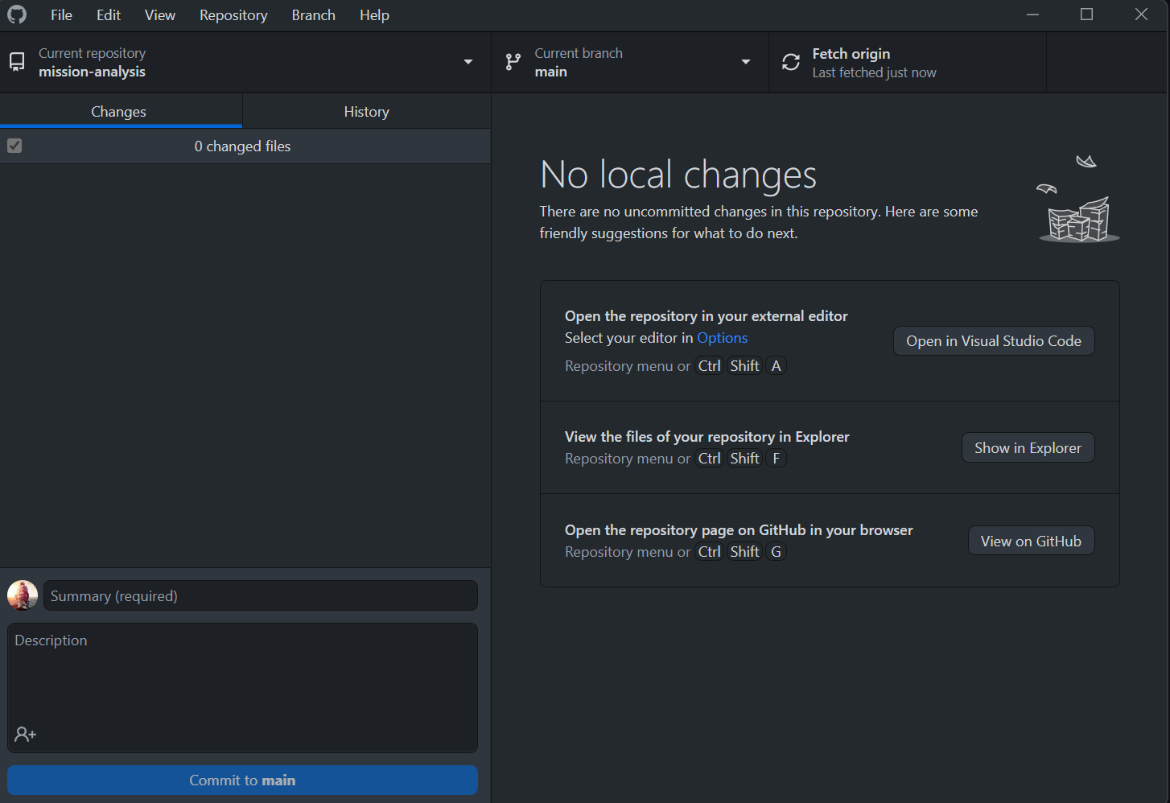
Collaborative Coding - GitHub
To join the TOLOSAT GitHub organization → give your username/email to the person linked on the page
TOLOSAT
05/2021
Mission Analysis in Python
11

Slide 12
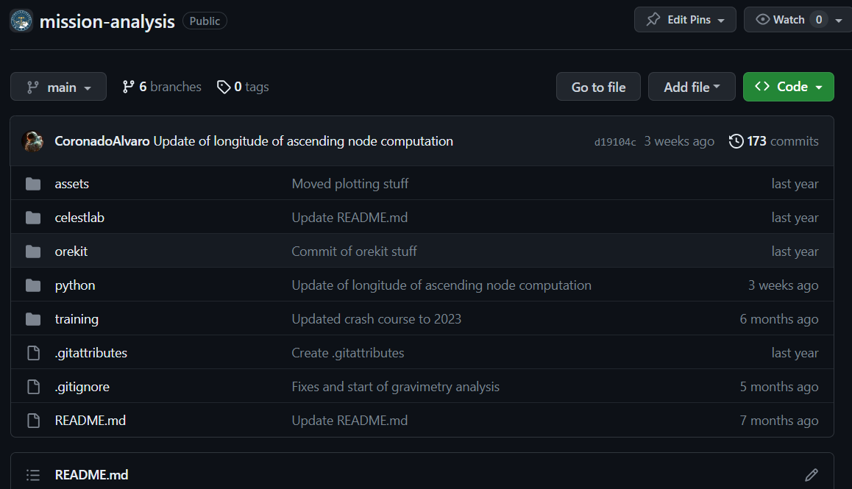
Mission Analysis repository
TOLOSAT
Assets: TOLOSAT logos
CelestLab & Orekit: Outdated
Python: Current!
Training: Setup Tutorials and Slides
05/2021
Mission Analysis in Python
12

Slide 13
Python folder (our baby)
TOLOSAT
Attitude: Functions to compute attitude and reference frame conversion.
Gravimetry: Compute communication windows with GPS Constellation.
input_data: Dates, Ground Stations, Orbits and Spacecrafts input parameters.
Iridium: Compute communication windows with Iridium NEXT Constellation.
Long_term_eclipses: Compute eclipses in orbit.
setup_guide: readme with installation setup.
useful_functions: Constants and different useful functions. (We should update Constants).
Visualization: Generating .vts visualization files with desired parameters.
05/2021
Mission Analysis in Python
13

Slide 14
Useful Links
TOLOSAT GitHub : https://github.com/TOLOSAT
Mission Analysis Repository : https://github.com/TOLOSAT/mission-analysis
Detailed setup guide (with more links) : https://github.com/TOLOSAT/mission-analysis/blob/main/python/setup_guide/README.md
GitHub Desktop : https://desktop.github.com/
ANACONDA : https://www.anaconda.com/
Miniforge : https://github.com/conda-forge/miniforge
PyCharm : https://www.jetbrains.com/pycharm/
PyCharm license for students : https://www.jetbrains.com/shop/eform/students
GitHub Global Campus for students : https://education.github.com/globalcampus/student
Tudat documentation : https://docs.tudat.space/en/stable/
Tudatpy API Reference : https://py.api.tudat.space/en/latest/
VTS Timeloop: https://timeloop.fr/vts/download/
TOLOSAT
Mission Analysis in Python
14

Slide 15
The End
… or the beginning !
10/2023

Slide 16
To do:
TOLOSAT
Create a GitHub account (if needed)
Provide GitHub account/email to Álvaro (me) to be added to TOLOSAT org
Follow setup guide: https://github.com/TOLOSAT/mission-analysis/tree/main/python/setup_guide
Apply to GitHub Global Campus student program to gain access to GitHub Copilot (student card needed).
05/2021
Mission Analysis in Python
16

